Slide 1
NEO4J CYPHER TUTORIAL WITH PYTHON
Map Iteration In Neo4j Using Cypher ,Apoc & Python
Tutorial 84

Slide 2
Sample map data
{
"0":{
"Train_Name":"A-C-S",
"Station":"[{'NAME': 'Euclid Ave'}]",
"count":1
},
"1":{
"Train_Name":"D-F-N-Q",
"Station":"[{'NAME': 'Coney Island - Stillwell Av'}]",
"count":1
},
"2":{
"Train_Name":"4-6-6 Express",
"Station":"[{'NAME': 'Spring St'}, {'NAME': '116th St'}, {'NAME': '103rd St'}, {'NAME': 'Bleecker St'}, {'NAME': '110th St'}, {'NAME': '28th St'}, {'NAME': '68th St - Hunter College'}, {'NAME': '23rd St'}, {'NAME': '51st St'}, {'NAME': '77th St'}, {'NAME': '96th St'}, {'NAME': '33rd St'}, {'NAME': 'Canal St'}, {'NAME': 'Astor Pl'}]",
"count":14
},
}

Slide 3
Use case
Map Iteration In Neo4j Cypher using apoc procedure

Slide 4
Pre-requisites
apoc.import.file.enabled=true
apoc.import.file.use_neo4j_config=false

Slide 5
Generate output with Train name and corresponding station names(must be in list)
code
call apoc.load.json("file:///Users/roni/Documents/GitHub/neo4j_python_use_cases/output.json")
yield value
with value
unwind keys(value) as key
return value[key]["Station"] as Station_Name ,value[key]["Train_Name"] as Train_Name

Slide 6
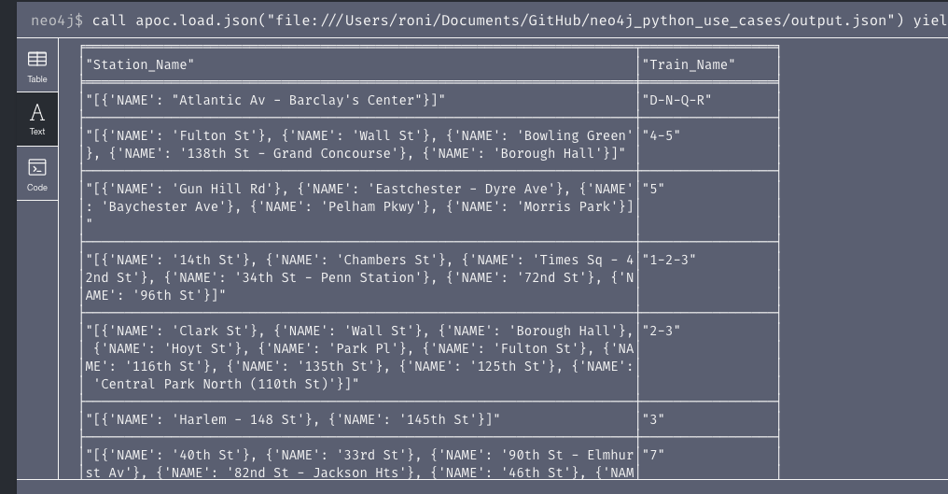
output
From neo4j browser

Slide 7
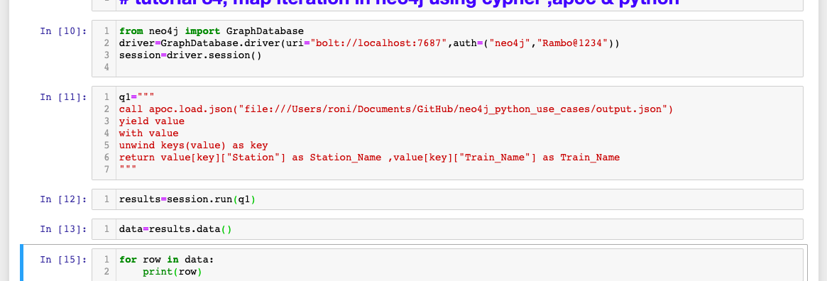
Python code
Map iteration using in cypher using python ,& apoc procedures

Slide 8
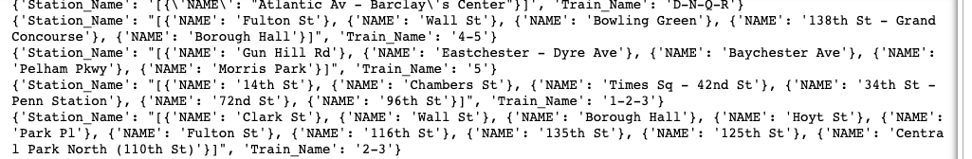
output
From python

